Slide 1
What was the experience of ‘People of Colour’ in Tudor England?
The Historian Miranda Kauffman has explore the lives of ‘people of colour’ in Tudor England. It is a mistake for us to think that There were no ‘people of colour’ in England 400 years ago. We often think that immigration is a recent phenomenon. This is the chance for you to see part of the history of ‘people of colour’ in Britain.
Task 1 – read though the details of the people on slides 3 to 10. Choose five of them and record details about them on the table on slide 2.
Task 2 – Read the extract from Kauffman’s book on slide 11 and consider the questions.

Slide 2
What was the experience of ‘People of Colour’ in Tudor England?
Person’s name: | Where did they live? | What do you find interesting about their life? Write down any details that you think tell us something new about Tudor history. | What does their story reveal about the lives of ‘People of Colour’ in Tudor England?

Slide 3
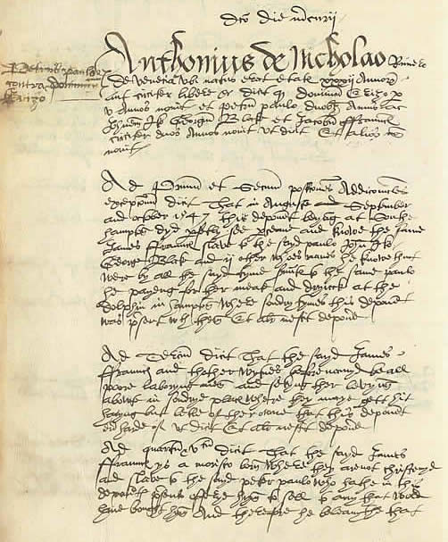
Jacques Francis, the salvage diver
Jacques Francis was an expect swimmer and diver, which were skills common in his native land, but extremely rare in Tudor England.
He was hired as part of a team to salvage (go and collect and recover) guns from the wreck of a ship, the Mary Rose, in 1546.
Francis had a Venetian master, Peter Paulo Corsi. Corsi was accused of theft by a group of Italian merchants based in Southampton. Francis became the first known African to give evidence in an English court of law, as he sought to defend his master.
An extract from the court record where Francis provided evidence to support his master.
‘his Black diver Jacques Francis and other named servants of Corso’s’

Slide 4
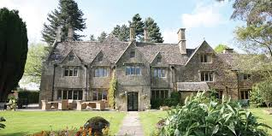
Edward Swarthye, the porter
‘In White Cross Manor, in the last decade of Elizabeth I’s reign, a Black Tudor, known as Edward Swarthye, alias ‘Negro’ whipped an Englishman named John Guye.’
In 1596, Edward Swarthye whipped John Guye. Both Swarthye and Guye were servants in the Gloucestershire household of Sir Edward Wynter: Guye managed the iron works, whilst Swarthye was a porter.
Swarthye had probably been brought home by Wynter after he captained the Aid on Francis Drake’s Caribbean raid of 1585-6. Swarthye was one of many Africans who fled their Spanish enslavers to join the English.
The whipping was one incident in an ongoing family feud between the Wynters and their neighbours the Buckes. Edward Swarthye appeared as a witness in the ensuing court cause in 1597, his testimony confirming that he, a Black Tudor, had whipped a white man before a crowd assembled in the Great Hall at the Wynter’s home, White Cross Manor.

Slide 5
Reasonable Blackman, the silk weaver
Reasonable Blackman made an independent living as a silk weaver living in Southwark c.1579-1592. The silk industry was new to England but its products were the height of fashion.
He had probably arrived in London from the Netherlands, which had both a sizeable African population and was a known centre for cloth manufacture.
He had a family of at least three children, but sadly lost a daughter, Jane, and a son, Edmund, to the plague that struck London in 1592.

Slide 6
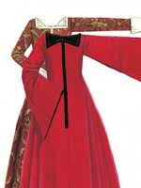
Mary Fillis, the Moroccan convert
Mary Fillis was the daughter of a Moroccan basket weaver and shovel maker. She came to London around c.1583-4 where she became a servant to John Barker, a merchant.
By the time of her baptism in the summer of 1597, she was working for a seamstress from East Smithfield named Millicent Porter. Porter died on 28 June 1599 but we do not know what happened to Fillis after this.
She was present in London during a period which saw a succession of ambassadors arriving in England from her native land of Morocco in order to negotiate alliances against the common enemy: Spain.

Slide 7
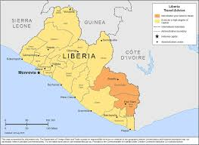
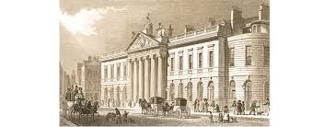
Dederi Jaquoah, the prince of River Cestos
Jaquoah was the son of King Caddi-biah, who ruled a kingdom in modern-day Liberia known for its meleguetta pepper or ‘grains of paradise’ and ivory.
He arrived in England aboard the Abigail in the autumn of 1610, and was baptised in the City of London church of St. Mildred’s Poultry on New Year’s Day 1611. He spent two years in England with John Davies, the leading Guinea merchant of the day, before returning home.
In 1615, he received a delegation (task) of East India Company merchants en route to Bantam. They reported that he spoke good English and made ‘great proffers and promises of trade’.

Slide 8
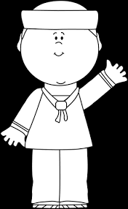
John Anthony, mariner of Dover
John Anthony was a sailor who almost certainly came to England with the pirate Sir Henry Mainwaring. In 1619 he was employed aboard The Silver Falcon, a ship on a voyage to Virginia.
If all had gone to plan, Anthony- a free, waged sailor- would have been the first African to arrive in an English colony in mainland North America. However the ship only made it as far as Bermuda, where it acquired a cargo of tobacco in dubious circumstances, before docking unexpectedly in the Netherlands. A bitter dispute followed between the owner of the ship, Lord Zouche, and the principal merchant in the venture. This held up the payment of John Anthony’s wages but after petitioning Lord Zouche, he eventually received payment with interest in the spring of 1620.

Slide 9
Cattelena of Almondsbury, independent single woman
Cattelena lived in the small Gloucestershire village of Almondsbury, not far from Bristol, until her death in 1625.
An inventory survives of the goods she owned. Her most valuable possession was a cow, which not only supplied her with milk and butter but allowed her to profit from selling these products to her neighbours.
No furniture is listed, which suggests she may have shared her home, perhaps with Helen Ford, the widow who administered her estate. Her possessions, from her cooking utensils to her table cloth, each tell us something of her life, but the fact that she had them at all tells us even more. Africans in England, like Cattelena, were not owned, but possessed property themselves

Slide 10
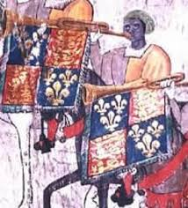
John Blanke, a royal trumpeter
The two images of the court trumpeter John Blanke in the Westminster Tournament Roll of 1511 comprise the only known portrait of a Black Tudor. He was present at the court of Henry VII from at least 1507, and may have arrived with Katherine of Aragon in 1501, when she came from Spain to marry Henry VIII’s older brother, Prince Arthur.
In 1509 he performed at both Henry VII’s funeral and Henry VIII’s coronation. He was paid wages and successfully petitioned the new king for a pay rise. He married in 1512, and was given a wedding present by Henry VIII, but after that he disappears from the records…

Slide 11
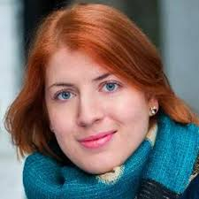
Below is an extract from the introduction of influential historian Kaufmann’s book on Black Tudors. Read it through and consider what life might have been like for Black Tudors but also what Tudor society was like more generally.
Miranda Kaufmann, Black Tudors: The Untold History (2017)
Understanding the world of the Black Tudors means becoming familiar with the sixteenth-century mind-set, and its ideas about religion, politics, life and death, so very different from our own.
When the Black Tudors encountered Tudor Englishmen, they found a people who, though certainly xenophobic on occasion, were deeply curious about the world beyond the seas. Most English men and women knew little or nothing of the world beyond their parish boundary. A ‘stranger’ was simply someone form outside the parish.
Tudors were far more likely to judge a new acquaintance by his or her religion and social class than by where they were born or the colour of their skin, though these categories did on occasion intersect.
How Africans were treated by the church tells us a lot about where they stood in Tudor England. This was a deeply religious society, in which life after death was no abstract ideal but the foundation of daily life. Death was impossible to ignore; high child mortality rates and a range of gruesome, incurable diseases conspired to impose an average life expectancy of just thirty-eight years. Was a Black Tudor’s acceptance into a parish community through the rituals of baptism, marriage and burial an effacement of African identity, or was the promise of eternal life the greatest gift a Christian society could bestow?
Social class governed society. Everyone, from the King (who ruled by divine right), through the aristocracy, to the gentry, yeoman and husbandmen, down to the lowliest vagrant, occupied a particular place in the ‘Great Chain of Being’. When Africans arrived in England as ambassadors, they were treated as such, but when they arrived abroad a captured ship, they found themselves at the bottom of the pile. Those who had skills, such as musicians, sailors or craftsmen, fared better. In many ways, their lives were no worse than those of the vast majority of Tudor: ‘nasty, brutish and short’, but this was the result of having no social standing, not of having dark skin.
Questions to consider:
What does Kaufmann argue were the main reasons a person might be judged in Tudor society?
What impact do you think being a ‘Person of Colour’ had on the experience of Black Tudors?
CHALLENGE: What primary sources might we need as evidence for the claims that Kaufmann is making?
Potential primary sources from the Tudor period:
Inventories (lists of individual property)
Parish records
Baptism records
Burial records
Court records
Marriage records
Diaries
Letters

