Slide 1

Thomas Deacon Academy
Geography Department
The Big Picture:
How are rocks created? How important are they and landforms they produce?
Prior Learning:
What are the three types of rock?
How does weathering happen?
Where did Britain's rocks come from?
Why is Limestone scenery so distinctive?
Should we be quarrying?
How dangerous are rock falls?
How were the Dartmoor Tors formed?
Current Learning:
What is the Giant’s causeway like?
Write this as your title
Future Learning:
Assessment
Learning Objectives
You will be able to:
Develop your creative writing skills in response to a natural landform as a stimulus
Understand how the Giants causeway was created and what it’s characteristics are
Key terms:
Write these in your margin
Igneous
Basalt
Hexagonal
Landform

Slide 2
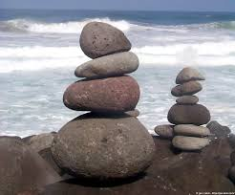
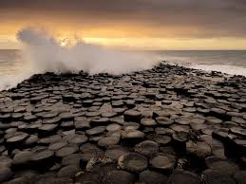
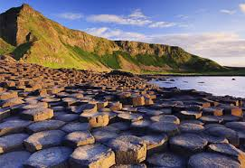
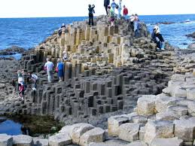
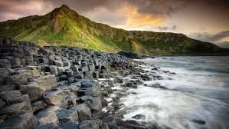
Opening activity – Creative writing
You have 10 minutes to write a story inspired by the images below… it does not have to be a geographical story so use your imagination!
ROCKS
What is the Giants Causeway like?
Learning Objectives
You will be able to:
Develop your creative writing skills in response to a natural landform as a stimulus
Understand how the Giants causeway was created and what it’s characteristics are

Slide 3
Creative writing – score your work
ROCKS
Score -5 if you:
Started the story with a, there, the, one, it, he/she/I
Did not include any speech in your story
Score +5 if you:
Started the story with a noun or an adjective
Used exciting punctuation (? ! “ ” … : ; )
What is the Giants Causeway like?
Learning Objectives
You will be able to:
Develop your creative writing skills in response to a natural landform as a stimulus
Understand how the Giants causeway was created and what it’s characteristics are
Score -1 each time you:
Forgot the capital letter, including for names
Forgot the full stop
Spelt a lot as ‘alot’
Little variation of sentence type
Score +1 each time you:
Added a new character
Used good vocabulary to help reader understand what it’s like to be there
Used a connective
Included a geographical idea

Slide 4
Creative writing
You have 5 minutes to improve your story. Write the changes in purple pen please.
ROCKS
What is the Giants Causeway like?
Learning Objectives
You will be able to:
Develop your creative writing skills in response to a natural landform as a stimulus
Understand how the Giants causeway was created and what it’s characteristics are

Slide 5

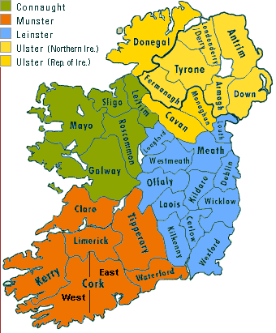
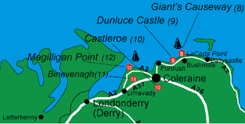
So where is the Giants Causeway?
ROCKS
What is the Giants Causeway like?
Learning Objectives
You will be able to:
Develop your creative writing skills in response to a natural landform as a stimulus
Understand how the Giants causeway was created and what it’s characteristics are
It is in County Antrim, on the NE coast of Ireland.

Slide 6

Facts
Columns are formed of basalt
Basalt is an igneous rock – it comes from volcanoes
The eruption was 50-60 million years ago
The lava cooled slowly to create columns
There are 40,000 interlocking columns
The tallest are 12m tall
ROCKS
What is the Giants Causeway like?
Learning Objectives
You will be able to:
Develop your creative writing skills in response to a natural landform as a stimulus
Understand how the Giants causeway was created and what it’s characteristics are
https://www.youtube.com/watch?v=bBARpgnYKvU

Slide 7

Your tasks …
Choose ONE of these tasks….
Write a script for a radio advert encouraging people to visit the Giant’s Causeway.
Write your opinion on whether the Giant’s Causeway is worth visiting or not.
Write your own legend about how the Giant’s Causeway was created.
You have 15 minutes!
ROCKS
What is the Giants Causeway like?
Learning Objectives
You will be able to:
Develop your creative writing skills in response to a natural landform as a stimulus
Understand how the Giants causeway was created and what it’s characteristics are

Slide 8
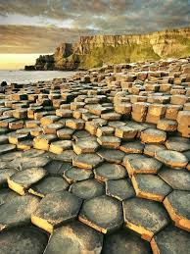
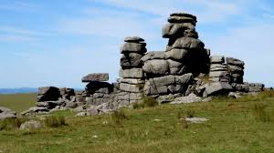
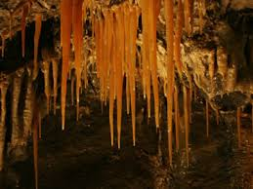
A thunk
Who would win in a fight…. A tor, a Giant’s Causeway column or a stalactite?
ROCKS
What is the Giants Causeway like?
Learning Objectives
You will be able to:
Develop your creative writing skills in response to a natural landform as a stimulus
Understand how the Giants causeway was created and what it’s characteristics are

Slide 9

Closing activity
What is the Giant’s Causeway like?
ROCKS
What is the Giants Causeway like?
Learning Objectives
You will be able to:
Develop your creative writing skills in response to a natural landform as a stimulus
Understand how the Giants causeway was created and what it’s characteristics are
Answer today’s title question. Give as much detail as you can, and remember to use today’s key terms!
Igneous Basalt
Hexagonal Landform

