Slide 1
Top 11 facts on …. Examinology and revision

Slide 2
11. Set the scene!
It is impossible to revise effectively in a space which has distractions.
Take some time to sort out a space that will work for you. Things to consider:-
- can you leave all your revision materials out?
- do you have all your resources nearby?
- will other people need the space?
- is there some fresh air & natural light?
- how many gadgets are in the space?

Slide 3
10. Set the timer
You need to keep to short revision sessions as:
concentration wanders after a while
You need to allow time to revisit ideas
You might need to start on 10min sessions, but build up to a max of 40 mins.
Then reward yourself with a short (5-10 min) break
The key is to be fully focused the WHOLE time you are revising

Slide 4
9. Have a plan
You should know what you are going to revise well in advance of sitting down to do it!
Create a revision plan to make sure you dedicate equal time to all subjects.
Use the PLC/course spec to RAG the topics; revise the red ones first as they need most work!
Make sure you plan in time to revisit each topic

Slide 5
8. Which way?
Everyone is different and so we all find different ways useful… but most people agree just reading notes is not the most effective!
Try lots of different methods – read and summarise, test yourself, define key terms, revision clocks, quizzes, flashcards, mind maps etc.
Consider the layout/presentation of material so it can be re-used, transported easily etc.
Make revision as much ‘fun’ as you can!

Slide 6
7. When should you do it?
It depends what suits you, but ideally it should fit into your normal day; getting up very early or staying up later will just make you tired and lack concentration!
Most people find they are more responsive in the morning
You may find you have some wasted time in the day that you could use e.g. the bus ride to school

Slide 7
6. What about before the exam?
Some basic preparation will help:
Have a good nights sleep beforehand
Make sure you know the time and room
Arrive in plenty of time
Make sure you have eaten and used the toilet!
Check you have the right equipment
Be aware of any rules/requirements
Not cramming facts on the way into the exam

Slide 8
5. Sticking to time
Make sure you know how long you have for each section; on paper 1 and 2 you have 20 minutes for each of the 3 topics
Use the time fully; go over answers and add detail where you can
There is time to BUG the question too; this will help you really focus on what you are being asked to do
You do not have to complete the paper in order; consider starting with your fav topic to increase your confidence.

Slide 9
4. Know your command words
Make sure you know what the question is asking you to do!
Most people get explain and describe mixed up
Many do not know what suggest means
Often people think compare and contrast are the same
Check for other important instructions e.g. describe one effect (2 marks), explain the social impacts of… etc

Slide 10
3. Don’t forget diagrams
You may be asked to draw, label, annotate or interpet a photo or diagram – make sure you have practised them!
Add one if you can explain it better than in writing
Draw them in pen as the exam is scanned and emailed to the examiners.

Slide 11
2. Practise your skills
Questions will cover a wide range of skills; practise them all!
Map reading; grid references, direction and distance, map symbols, relief etc.
Maths skills; mean, median, mode, interquartile range, percentages, data from tables etc.
Photo interpretation, cartoon and diagram analysis etc

Slide 12
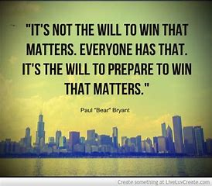
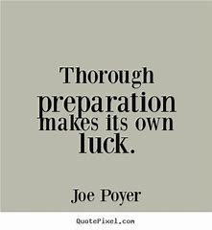
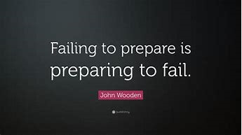
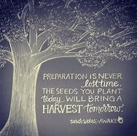
1. Preparation is everything!

