Slide 1
Top 11 facts on …. People of the Planet

Slide 2
11. What is development?
Growth, improvement, advancing

Slide 3
10. How do we measure development?
Development indicators are used, but have some problems
Some problems with indicators are that some data can be unreliable, can hide differences within countries, and that they don’t indicate any other impacts.
Social | Birth rate, death rate, infant mortality rate, literacy rate, Doctors per 1000 etc. All linked to quality of life
Economic | GDP/GNI per capita, employment type, number in absolute poverty etc All linked to employment and wealth

Slide 4
9. Why is development uneven?
Physical | Human
Natural resources e.g. is there fuel? Do they have clean water? Natural Hazards e.g. any events that damage infrastructure? Any benefits from hazards? Location and terrain e.g. are they landlocked? Is the land difficult to build on or attractive to tourists? Climate e.g. is the rainfall reliable? Does the climate affect people’s health? | History e.g. were they colonized? When did they go through industrialization? Healthcare e.g. does everyone have access to vaccines? Are there any key diseases? Politics e.g. do these r/ships impact on trade? Are TNC’s allowed in? Technology e.g. can people access the internet? Is there an electricity supply?

Slide 5
8. What are the impacts?
Uneven distribution of wealth – 48% of worlds wealth is owned by 1% of the population
Uneven healthcare means poorer countries have high birth, death and infant mortality rates, and low life expectancy.
Uneven education – UK literacy rate is 99%, Ethiopia is 36%
Uneven standards of living – lack of infrastructure, sanitation, running water etc. in poorer countries

Slide 6
7. How do we classify countries?
AC’s
EDC’s
LIDC’s
Classified by the IMF
Based on wealth, trade & links to other countries

Slide 7
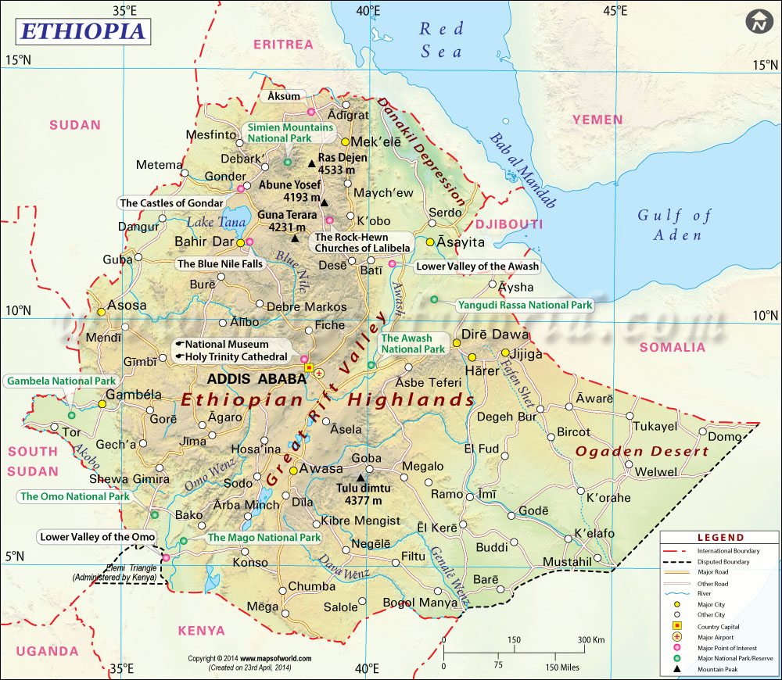
6. Ethiopia – where?
Which factors could have slowed their development?

Slide 8
5. Ethiopia trade
Mostly export primary goods
80% of exports are from agriculture (coffee 28%, veg 15%, livestock 23% etc)
Exports valued at $3 billion
Mostly import manufactured goods
11% petroleum based, 4% trucks, 3% fertilizers etc.
Imports valued at $11 billion (gives trade deficit of $8billion per year)

Slide 9
4. Ethiopia - links
Imports from: Italy, Kuwait, Saudi Arabia, India, China
Exports to: Switzerland, Germany, Somalia, Saudi Arabia, China,

Slide 10
3. Ethiopia – TNC’s
TNC’s (e.g. H&M, Hilton Hotels, GE) are locating in Ethiopia
Positives – creates jobs, increases tourism, improved facilities etc.
Negatives – low pay, seasonal jobs, low working standards etc.

Slide 11
2. Ethiopia - Aid
Charities (e.g. Oxfam & Farm Africa) have been working in Ethiopia
Positives – debt relief (from $10 billion in 1995 to $7 billion in 2012), raise status of girls, etc.
Negatives – corruption, unequal distribution, over-reliance etc.

Slide 12
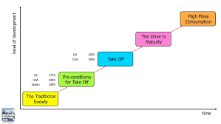
1. Rostow’s model

