Slide 1
Thomas Deacon Academy
Geography Department
The Big Picture:
What is the future for the Middle East?
Prior Learning:
What are the human and physical features of the Middle East?
What is the climate of the Middle East?
How do plants and animals live in the desert?
How is the population distributed across the Middle East?
How important are the Middle Eastern oil reserves?
What has caused the Syrian conflict?
Current Learning:
Will there be water wars in the future?
Write this as your title
Future Learning:
Assessment
Learning Objectives
You will be able to:
Understand water is a valuable resource
Identify and explain the reasons why water is running out
Assess whether water may be a cause of conflict in the future
Key terms:
Write these in your margin
Water stress
Water scarcity

Slide 2
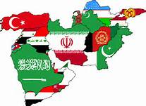
Definitions
Water stress occurs when the demand for water exceeds the available amount during a certain period or when poor quality restricts its use.
Water scarcity is the lack of sufficient available water resources to meet the demands of water usage within a region.

Slide 3
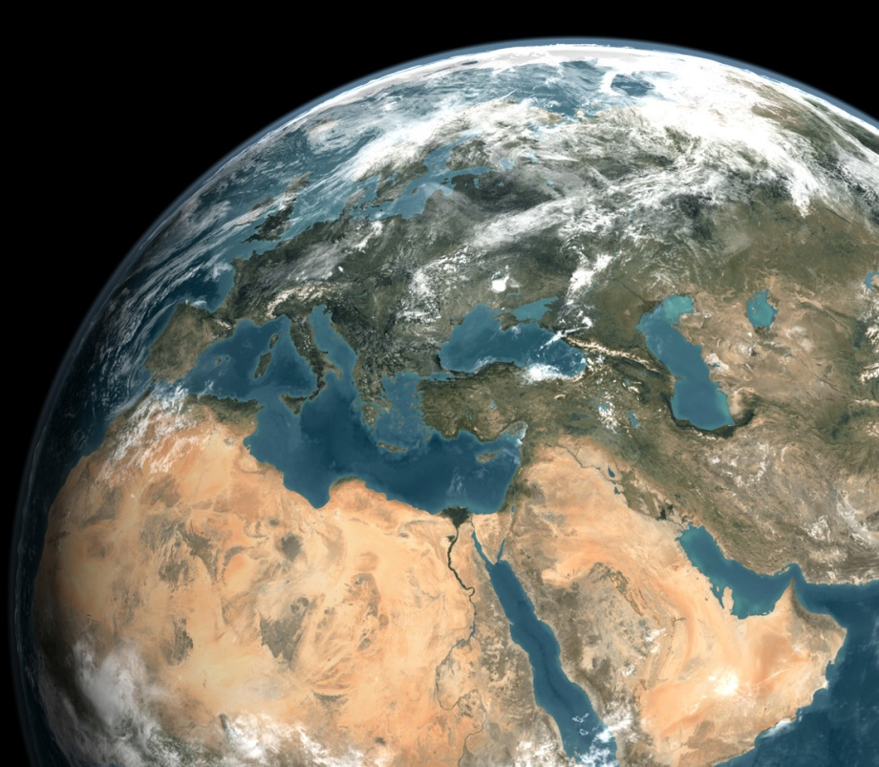
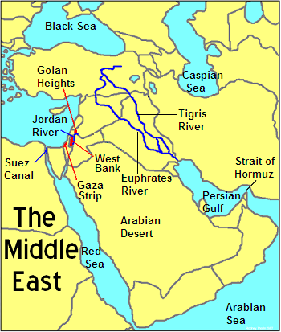
The importance of water
At the back of your book write down all the things you use water for in a normal week.
Now cross out anything you could live without.
How important is water to your life?

Slide 4

Water Wars
https://www.youtube.com/watch?v=A6G7yyUea6M
Write down 10 facts from the video

Slide 5
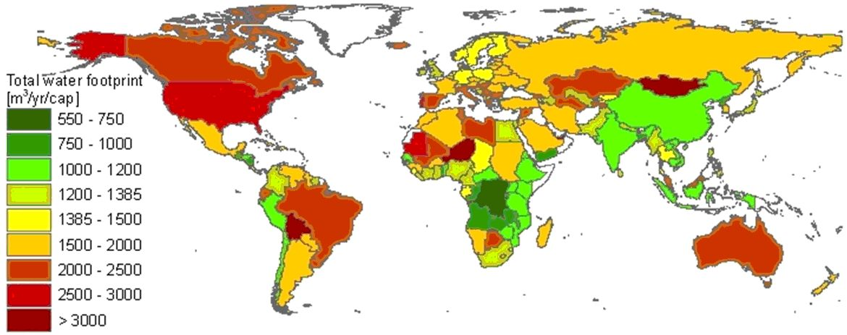
Water consumption
Describe the water footprint of the Middle East (i.e. say how much water they use)

Slide 6
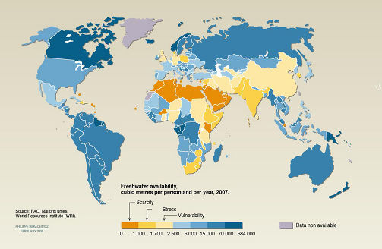
Water availability
Describe the water stress/scarcity of the area (i.e. describe how much water they have)

Slide 7
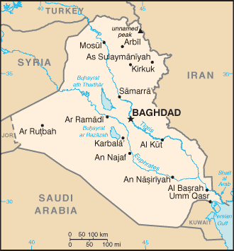
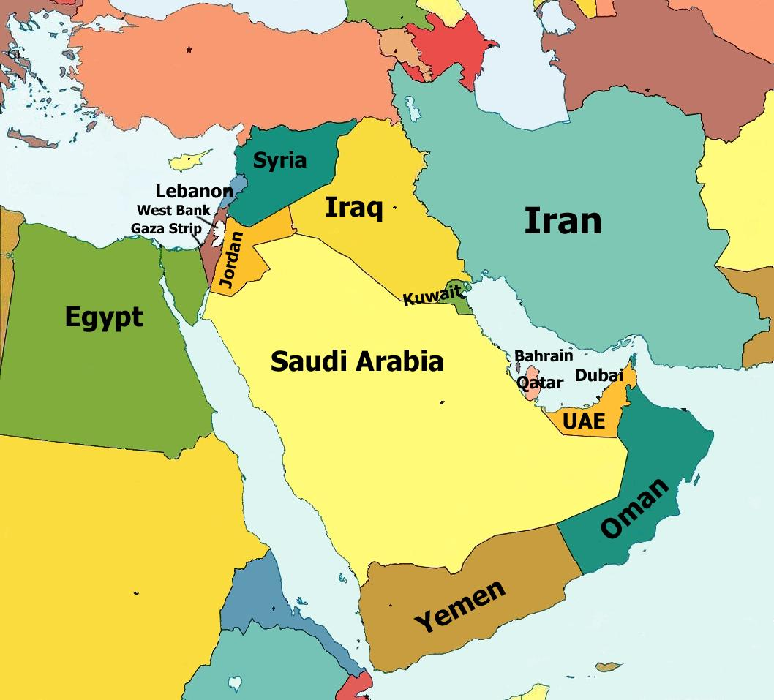
Why does the Middle East have an issue with water?
5% of the world’s population, but only 1% of the freshwater
Population growth due to developing countries being in stage 2 or 3 of the Demographic transition model
Increased affluence – demand in swimming pools and golf courses
Irrigated farmlands – 89% of extracted water used on crops
Depleting oil, meaning a lower income in the future, which means:
Desalination cannot be paid for
Imported food cannot be bought, so more grown in this region = increased water usage
Rising young population, causing a rise in demand for water
Many countries like Turkey and Israel depend on high yield crops for their wealth
The water in the region is interconnected e.g Euphrates River = conflicts arise
Climate change will make water shortages worse here
Pollution of water sources e.g Gaza aquifer
Salt water incursion due to over use of ground water stores e.g Israeli west coast

Slide 8
Exam Question
‘Referring to examples, assess the potential for water conflict in areas where demand exceeds supply’ (8 marks)
What does this question mean?

Slide 9
Exam Question
Name actual places
Weigh up – will it happen or not?
‘Referring to examples, assess the potential for water conflict in areas where demand exceeds supply’ (8 marks)
Chance or possibility
Wars/fights over water supplies
Need more than they have
In other words:
Decide whether one day countries that don’t have enough water will only be able to get it by fighting another country!

Slide 10
Exam Question
‘Referring to examples, assess the potential for water conflict in areas where demand exceeds supply’ (8 marks)
Use the information sheets to find facts you could include in your answer.
Write these facts onto the scales; one side is arguing there will be wars, the other is arguing there won’t be wars.
You should be able to decide your overall opinion by seeing how many ideas are on each side!

Slide 11
Exam Question - sentence starters
‘Referring to examples, assess the potential for water conflict in areas where demand exceeds supply’ (8)
One example to suggest that there is a potential for water conflict is …
This is very/quite likely to happen because …
Another example to suggest that there is a potential for water conflict is …
This is very/quite likely to happen because …
One example to suggest that there is not a potential for conflict over water is …
This is not likely to happen because …
A second example to suggest that there is a not a potential for water conflict is …
This is not likely to happen because …
Overall, conflict is very/not likely to happen in the future .

Slide 12

Closing activity
Will there be water wars in the future?
Answer today’s title question. Give as much detail as you can, and remember to use today’s key terms!
Water stress
Water scarcity

Slide 13
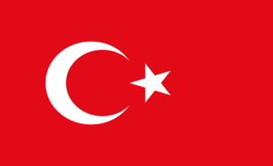
Conflicts in the region – a) Turkey
Turkeys GAP Scheme - Aims
$32 billion South Eastern Anatolia project to address droughts in Southern Turkey – effects major cities of Ankara and Istanbul
Turkey aims to be the ‘breadbasket’ of the middle east – will therefore increase cash crops ( fruits, veg)
Socio-economic development – create better education , healthcare, more jobs and so stop outmigration
What it will do
22 dams, 19 HEP plants, which produce 22% of turkey energy by 2010
Irrigate over 1.7 million hectares and support 7% of the population
South East Anatolia economy will grow by 400%
Will dam the Euphrates and Tigris rivers
Concerns
Syria and Iraq are unhappy as these rivers provide most of there water. This makes it a Geopolitical issue ( geography, economic and politics are interconnected)
Ilisu Dam on the Tigris was proposed but they could not initially get funding due to the impact this was going to have ( World Bank, Uk Gov, Skansa Swedish TNC all pulled out – key players) because it was going to :
Flood nearly 80,000 homes
Displace tens of thousands of Kurds
Cause waterborne disease and Malaria to occur more
Rotting veg would release methane and Co2 , so meaning it was damaging the environment
Future
2004 Ilisu Dam scheme amended ( still caused the displacement of the Kurds). Funded by 3 companies combining
Water was released to help out Syria, but not Iraq
New plan is to create Cizre Dam – will take water out of the Tigris for irrigation and so annoy Syria and Iran

Slide 14

b) Israel
Past
Israel had been in various conflicts to ensure that water pathways (how water flow )are kept clear e.g :
1967 Six day war – an Israeli reaction to the Syrian attempt to divert the River Jordan. It resulted in Israel gaining - West Bank from Jordan, Golan Heights from Syria and the Gaza strip from Egypt
1994 Jordan Peace treaty – Israel led agreements over the sustainable use of the Yarmouk river
2000 Summit at Camp David in the US. Israel offered up land to the Palestinians, but not water
2004/5 Turkey agreed to ship water to Israel in return for high tech military support
2005/6 The Litani River disputes between Lebanon and Israel
Where they get water from
Current over consumption of water by the Israelis is not sustainable. They use 2200 billion litres a year, but naturally only have 1700. Water comes from:
25% natural
The Sea of Galilee , fed by the river Jordan and tributaries in the Golan heights
Mountain Aquifers – mainly in the West Bank. This is shared 80% Israel, 18% Palestine, 2% unavailable
Coastal Aquifer – Israel controls 90% of this
Problems faced here:
Syria want the borders to be reinstated to before 1967 = Golan height would be Syrian = 25% of Israel’s water is threatened due to poor water management in Syria / GAP project making them divert the water here
Mountain Aquifers are in the disputed West Bank and urban growth has increased pumping – led to pollution
The coastal aquifers have been over pumped, leading to salt water incursion
The flow of the River Jordan is being over used and the Dead Sea is drying up
Lots of mistrust here between the Palestinians and Israelis, making the situation worse e.g the construction of the ‘dividing wall’ in the West Bank led of the destruction of wells and separated Palestinians from water sources. The line of the barrier follow the Western Mountain Aquifer, so giving Israel access to this water
Future
National Water Carrier system set up by government in 1959 – involved drip-fed irrigation to take water to the Negev Desert settlements
Recycling sewage water for agricultural uses 65% of crops grown this way
Increasing food imports, so reducing animal consumption
Better water treatment plants and conservation techniques
Water charges at ‘ real value’ by considering cost of supply and impact on ecosystem
50 million m3 shipped from Turkey each year The Manavgat Project
Piping seawater from the Red Sea and Mediterranean to inland desalination plants
25% of all supplies in 2020 met by desalination under the ‘Desalination MasterPlan. Currently a plant in Ashkelton
Importing water rich food – so expanding virtual water supplies

