Slide 1

Thomas Deacon Academy
Geography Department
The Big Picture:
What happens in our atmosphere?
Prior Learning:
What is the difference between weather and climate?
Which factors affect weather and climate?
Why does it rain?
What causes microclimates?
Assessment
What is Britain’s weather?
Why does extreme weather happen?
Current Learning:
How bad is climate change?
Write this as your title
Future Learning:
How bad is climate change? (part 2; solutions)
Learning Objectives
You will be able to:
Explain the human and natural causes of climate change
Assess the reliability of the evidence for climate change
Understand a range of impacts of climate change
Key terms:
Write these in your margin
Climate change
Global warming
Causes Evidence Impacts

Slide 2


Opening Activity –
What do you already know about climate change or global warming?
Stretch yourself:
Can you define climate change and global warning?

Slide 3

What’s in a name?
The names ‘global warming’ and ‘climate change’ often get swapped… does it make a difference?
http://www.youtube.com/watch?v=HGEkXQx9dP0&safe=active

Slide 4
Your Task:
Use the information sheets around the room to complete your worksheet (the sheets are at the end of this PPT; slide 11-17)
Extension: Answer this question in as much detail as you can ‘Are the causes of climate change mainly natural or mainly human?’
Stretch yourself:
Does it matter whether the causes are natural or human?

Slide 5
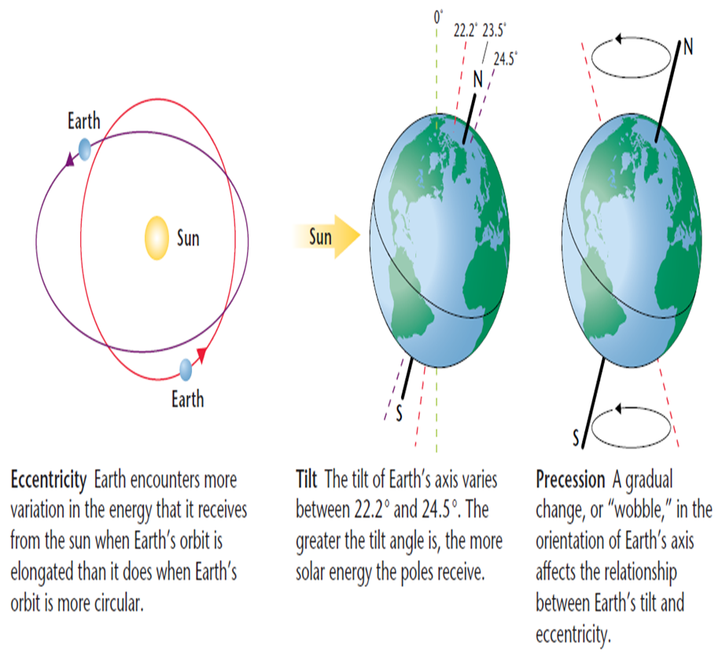
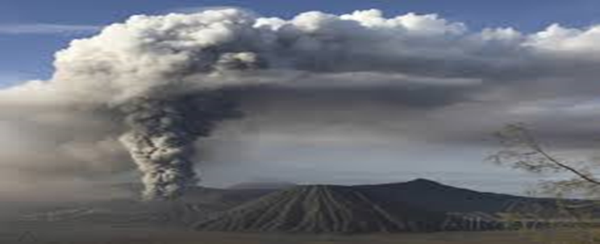
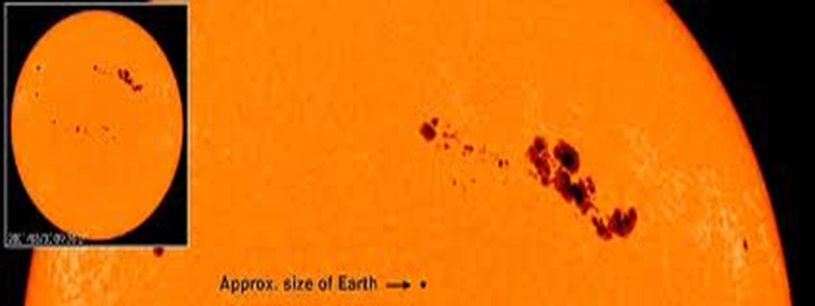
How do these natural causes work?
A) Milankovitch Cycles
C) Volcanic Emissions
B)Solar Output

Slide 6
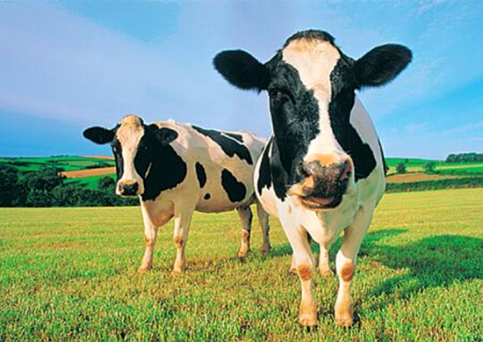
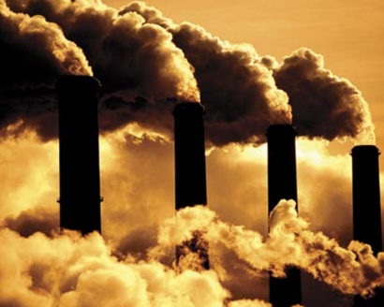
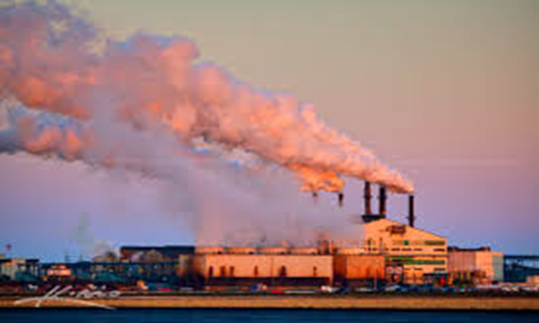
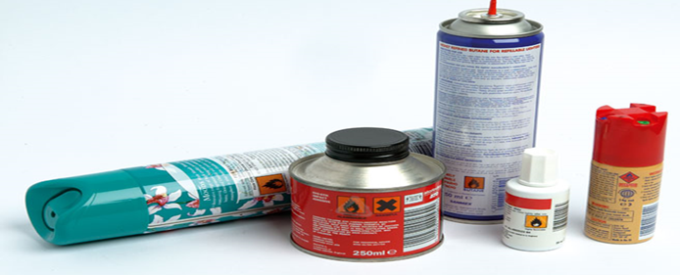
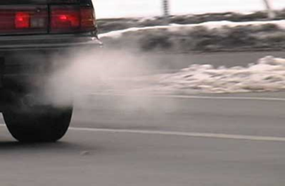
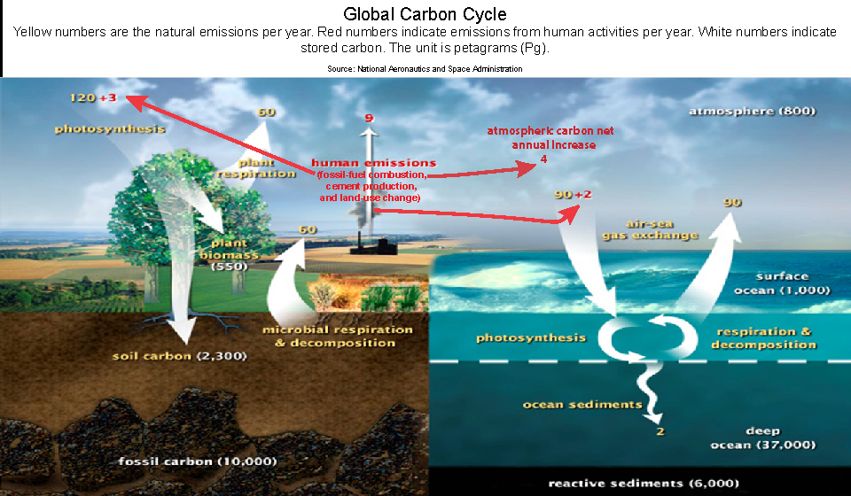
How do these human causes work?
A) Greenhouse Gases
C) Global dimming
B) Destroying Carbon sinks

Slide 7
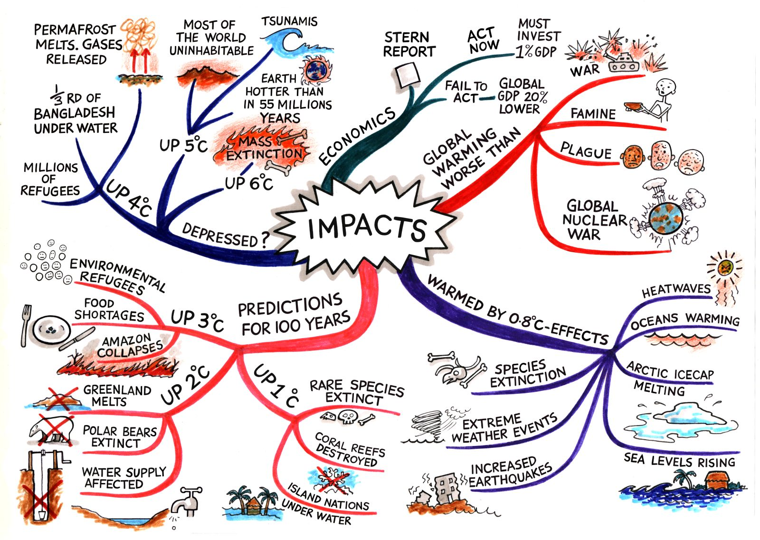
What impacts will global warming have?
Choose any 3 impacts and explain to a partner how those are caused by global warming and how serious they might be.

Slide 8
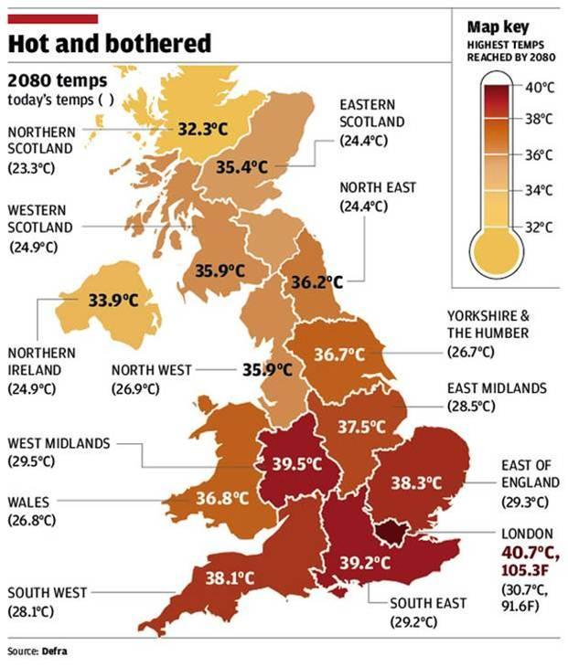
Impacts
If temperatures of the UK reach these levels in 2080, what could the effects be?
Use ‘so what?’ to expand your answer.
Stretch yourself: Why is it hard to predict the future impacts?

Slide 9
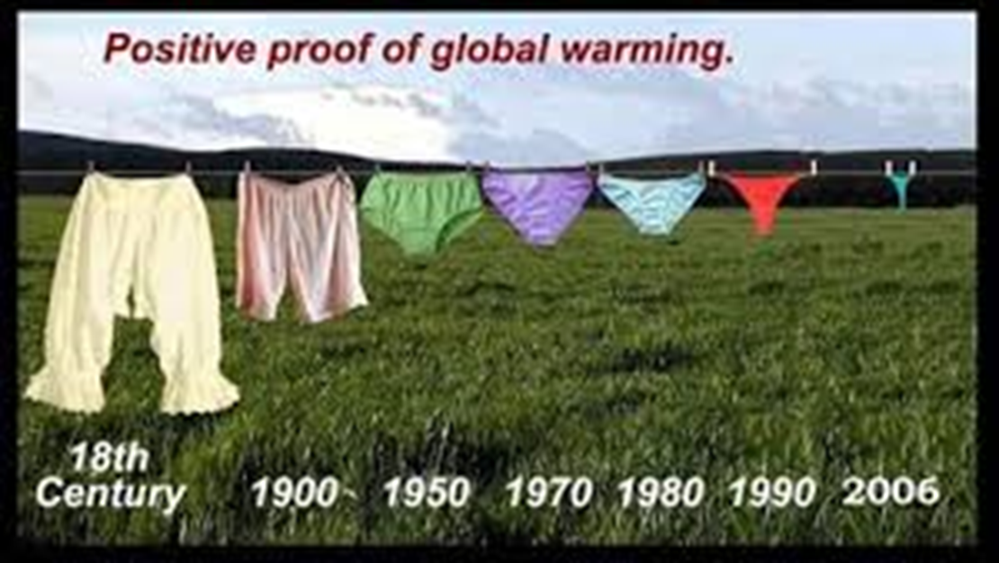
Is this enough proof global warming exists?
Stretch yourself:
Can you name other examples of ‘proof’ people may offer which is not scientifically sound?

Slide 10

Closing activity
How bad is climate change?
Answer todays title question. Give as much detail as you can, and remember to use today’s key terms!
Climate change
Global warming
Causes
Evidence
Impacts

Slide 11
Info sheets to go round the room!

Slide 12
Milankovitch Cycles
Milankovitch developed his theory in 1924.
He says the climate changes over time because the earth’s orbit around the sun changes over time
Orbital eccentricity - the shape changes from circular to elliptical over 100,000 years.
Axial Tilt – the earth’s axis changes from 21.5 to 24.5 over 41,000 years creating stronger seasonal temperatures
Axial Precession – every 22,000 years the earth ‘wobbles’ changing the point which is closest to the sun.

Slide 13
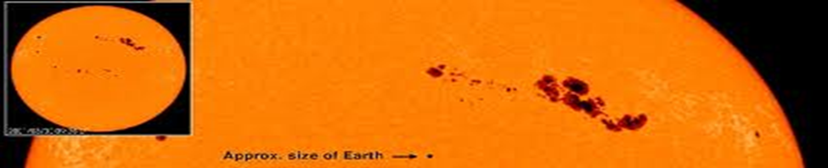
Solar Output
For centuries people have understood that there are variations in how much energy the sun sends towards earth.
When the sun has more energy, it can be seen as dark patches (called sun spots) on the surface of the sun.
That energy makes temperatures higher than usual on earth.

Slide 14

Volcanic eruptions
When a volcano erupts it releases ash, sulphur dioxide, water vapour and carbon dioxide into the atmosphere.
These particles form a haze which blocks the suns energy from reaching the earth, and reflects the heat back out to space.
This will make the temperature
colder than usual for 2-3 years.

Slide 15
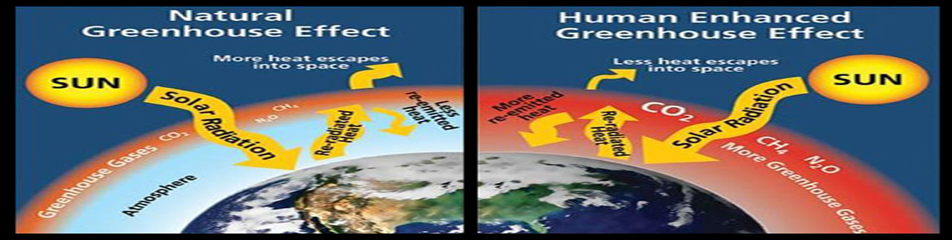
Greenhouse Gases (GHG’s)
Human activity release GHG’s such as methane, CO2, CFC’s and Ozone
GHG’s trap the sun’s energy in the atmosphere so it bounces around instead of going out to space
This heats up the earths surface temperature

Slide 16

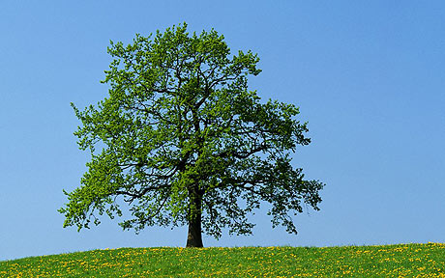
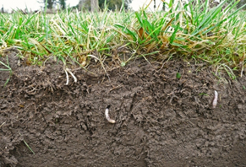
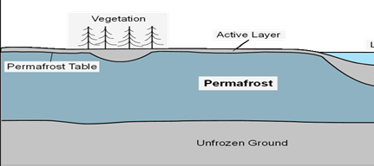
Destruction of Carbon sinks
A CO2 sink stores carbon dioxide away from the atmosphere, so it does not contribute to the greenhouse effect
The biggest sinks are the ocean, forests, the soil and permafrost
Human actions are damaging/ removing these stores so the CO2 is released back into the atmosphere

Slide 17

Global dimming
There are lots of cars and factories releasing pollution into the atmosphere.
This creates a haze in the air which will reflect the energy from the sun back to space.
The temperature will become cooler as the heat is reflected away

