Slide 1
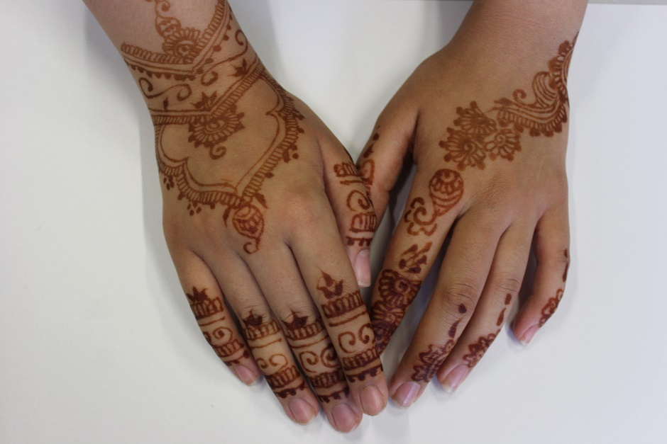
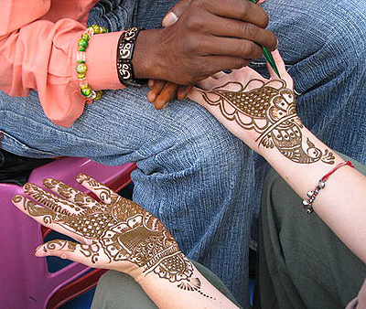
Design your own henna
Design your own henna pattern.
On a piece of paper, trace around your own hand. You then need to design and create your own henna pattern.
What is henna?
In many cultures, women have henna decorations applied to their hands and feet for festivals and celebrations. Before a wedding, a bride will have elaborate henna designs drawn onto her hands, arms and sometimes feet. In some regions, the groom will be decorated as well.

Slide 2
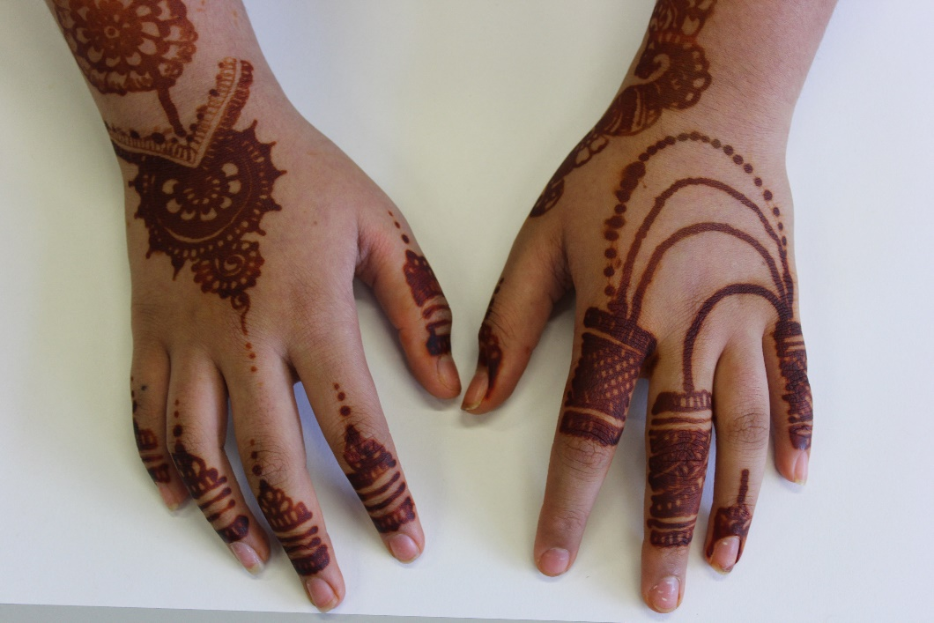
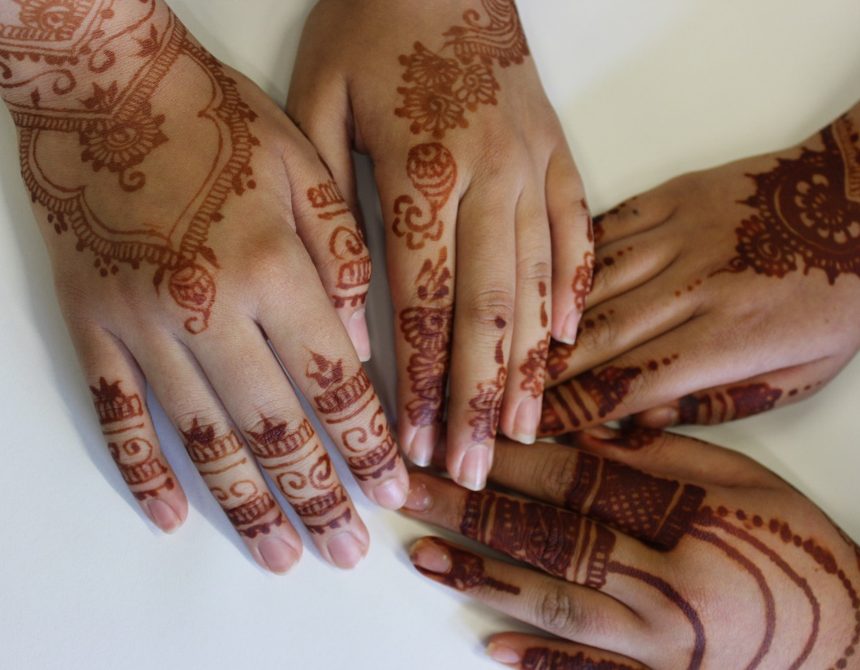
Examples of henna

